Slide 1
IN THE NAME OF GOD

Slide 2
Anxiety Disorders in Children
Sara Dehbozorgi

Slide 3
Normal and abnormal child anxiety
As anxiety disorders represent an extreme presentation of normal events, this distinction is essentially made on the basis of the severity and persistence of symptoms.
The extent to which irrational fears or worries cause significant distress or impairment in academic or social functioning.
The timing of symptoms
Developmentally appropriate worries fade with time and do not interfere with functioning, making them distinguishable from anxiety disorders.

Slide 4
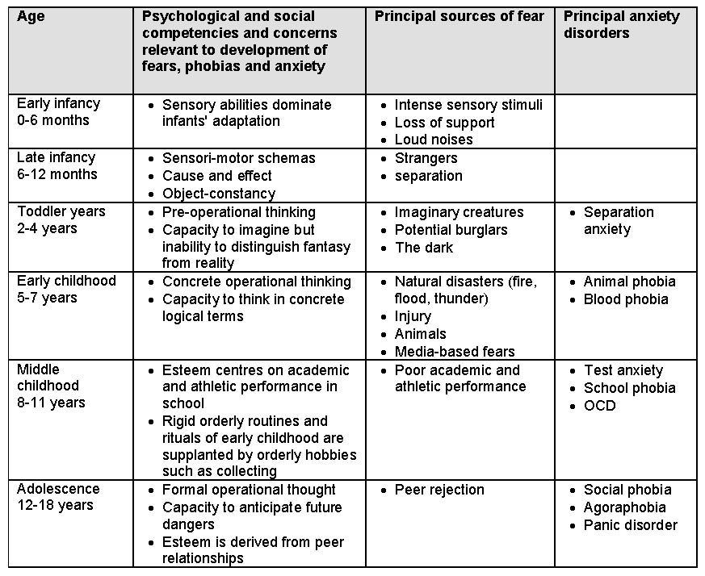

Slide 5
INTRODUCTION
Anxiety disorders are the most common psychiatric disorders in childhood and are associated with poor quality of life, depression , and significant societal costs.
Anxiety and fear are emotions that can be adaptive.

Slide 6
Many childhood anxieties are developmentally appropriate, highlighting the importance in considering the child’s age as well as sociocultural context.
For instance, an increase in separation anxiety distress and stranger anxiety are developmentally appropriate around age 8 months, with symptoms usually resolved by age 2 years.
Preschoolers are often afraid of the dark and monsters.
Youngsters in elementary school to be afraid during storms.

Slide 7
The tripartite view of anxiety individuals’ anxious responses consist of three components
behavioral or motoric
cognitive or subjective
physiologic

Slide 8
Epidemiology
The prevalence of anxiety disorders has varied with the age group of the children surveyed and the diagnostic instruments used.
Lifetime prevalence of any anxiety disorder in children and adolescents ranges from 10 percent to 27 percent

Slide 9
DSM-5
Agoraphobia has been classified as a stand-alone diagnosis (ie, no longer linked to the presence or absence of panic disorder)
SAD and selective mutism have been re-classified as anxiety disorders (rather than in a section for 'disorders usually first diagnosed in infancy, childhood or adolescence')
OCD, PTSD and ASD are, respectively, grouped under obsessive-compulsive and related disorders, and trauma-related and stressor-related disorders.

Slide 10
While core features of each anxiety disorder are consistent with DSM-IV, in order to minimibroadly se the over-diagnosis of transient fears for agoraphobia, specific phobia and social anxiety disorder, those under the age of 18 are now required to have had symptoms for at least 6 months.
Anxiety disorders: specific phobia, generalised anxiety disorder, social anxiety disorder (formerly social phobia), panic disorder and agoraphobia

Slide 11
Specific Phobia
Phobias involve excessive, specific, persistent fear of a stimulus as well as significaant avoidance or distress.
Phobic reactions are disproportionate to the demands of the situation, impervious to reasoning, and often occur outside the normal developmental period of a fear (e.g., fears of monsters in an older child).

Slide 12
Specific Phobia
SP is an excessive fear of a specific object or situation. Exposure to the object or situation consistently results in immediate excessive and irrational fear that may manifest as hiding, clinging, freezing, crying, screaming, vasovagal fainting (especially in blood and needle phobias), or autonomic arousal.
Symptoms must last for 6 months and cause significant avoidant behavior and/or distress, as well as functional impairment.

Slide 13
Phobias are divided into five categories:
Animals
Natural environment (e.g., lightning, heights, darkness)
Blood-injection-injury (including other medical procedures)
Situational (e.g., flying, driving, bridges)
Other (e.g., loud noises, choking, clowns)

Slide 14
Age of onset
Fears and phobias are common in young children.
Referral rates tend to increase in mid-to-late childhood and early adolescence. The peak age for referral of children diagnosed with specific phobia is 10-13 years, with the average age of symptom onset at approximately 8 years.

Slide 15
Age of onset
The mean age of onset of specific phobia depends on the type of phobia that develops.
Animal, blood, and storms and water-specific phobias typically develop in early childhood.
Height specific phobia develops in teenagers.
Situational specific phobias (eg, claustrophobia) typically develop during the late teenage years and early third decade of life.

Slide 16
Separation Anxiety Disorder
SAD is developmentally inappropriate anxiety or distress relating to separation from a major attachment figure or caretaker.
Children with SAD may worry about being kidnapped or lost and/or that separation may result in death or injury to their parents, and they will be unable to see their caretakers again.

Slide 17
SAD frequently presents after:
Parental loss
A significant illness in the family or child
Death of a pet
Other stressful events

Slide 18
Risk factors
Early traumatic separation from the attachment figuresuch as sudden hospitalization; death or divorce
Family history of anxiety disorders or depression
Over-protective, needy, or depressed parent.
Temperament (ie, level of anxiety dealing with new situations)

Slide 19
As an aside, school phobias may develop in patients after the addition of a neuroleptic. This phenomenon was initially reported with haloperidol and pimozide and is likely pharmacologically mediated (risperidone).

Slide 20
Manifestations
Refusal to sleep alone or be away from home.
Nightmares about separation.
Somatic symptoms such as headaches, stomachaches, muscle cramps, or dizziness. If somatic symptoms occur only when children are separated from attachment figures or when faced with separation (e.g., no somatic symptoms on weekends when there is no school).
Seeing shadows of monsters when left alone
Cling to their parents, follow them from room to room, and/or insist parental presence at all times (e.g., bathing).

Slide 21
Normal separation anxiety
Separation anxiety is developmentally normal in infants and toddlers until approximately age 3-4 years, when mild distress and clinging behavior occur when children are separated from their primary caregivers or attachment figures (eg, being left in a daycare setting).

Slide 22
Social Phobia
SoP is also known as Social Anxiety Disorder. It is an excessive and impairing fear of being negatively evaluated by others.
SoP must be accompanied by either avoidance of social situations or severe discomfort while enduring social situations.
In children, the anxiety cannot be limited to discomfort in social situations with adults. Children with SoP are unlikely to approach peers and often feel like others are watching them.

Slide 23
SoP is diagnosed, symptoms need to be present for 6 months and almost always occur in the feared social situation.
Impairment helps distinguish between normative shyness and SoP.

Slide 24
Examples of impairment include :
Difficulties making or keeping friends
limited romantic relationships
School refusal
Not participating in extracurricular activities
Significant child distress
Adolescents may abuse drugs prior to and/or during social situations in attempts to self-medicate.
Family life also is often disrupted as the child’s avoidance and impairment often constrains families’ engagement in fun activities.

Slide 25
Differential diagnosis
Avoidant personality disorder which is sometimes conceptualized as a severe variant of SoP .
Autism spectrum disorder is on the differential for SoP .however, children with SoP often have friends their own age and demonstrate improved social skills in established relationships. In many cases of autism spectrum disorder, a comorbid diagnosis of SoP is warranted.

Slide 26
Selective Mutism
SM is refusal to speak in particular settings. Children may speak at home but not school or in front of unfamiliar people. They may communicate by nodding, writing, making sounds in lieu of speaking.
Many children with SM rely on friends and parents to speak for them in social settings. Impairments due to SM include reduced class participation, academic underachievement, and isolation from peers.
Symptom must persist for 1 month and cannot be limited to the first month of school.

Slide 27
Selective Mutism
Children with SM are often shy and usually have comorbid social phobia.however, some enjoy participating in social activities that do not require speaking.
Communication and developmental disorders are frequently comorbid with SM, and children with SM, communication, and developmental disorders all present with a lack of speech.
What distinguishes children with SM from children with communication and developmental disorders is that the former have an ability to speak in certain social contexts but not in others.

Slide 28
Pediatric Generalized Anxiety Disorder
GAD is characterized by impairing worry about multiple situations for at least 6 months.
Children with GAD express worry about potentially negative occurrences on most days, and the focus of the worry may shift from topic to topic. The anxiety in GAD is often difficult to control and interferes with completing tasks or enjoying activities, which helps to distinguish pathologic from normal anxiety.

Slide 29
Children with GAD may have difficulties in:
Falling or staying asleep
Fatigue
Trouble focusing
Muscle tension
Irritability
Worry must be accompanied by one of these symptoms in childhood GAD (note, diagnosis of GAD in adults requires worry be accompanied by three of these symptoms).

Slide 30
Anxieties in GAD often involve everyday matters like completing assignments, being on time, getting good grades, and performance in sports.
Worry about anticipated changes and dangerous situations like storms, home invasion, or a family member getting sick is also common.
The worries can sometimes be fantastical (e.g., monsters in the basement) or extreme (e.g., terrorist attacks).

Slide 31
Children with GAD may seek reassurance about their performance or safety frequently.
GAD may also present as perfectionism, indecision for fear of making a poor choice, and a tendency to magnify minor mistakes.
Somatic symptoms also often manifest including headaches and stomachaches.

Slide 32
Treatment
Firstline interventions for childhood anxiety disorders are cognitive behavioral therapy (CBT) and treatment with SSRI.
SSRIs are effective treatments in pediatric anxiety
Atomoxetine, which selectively inhibits norepinephrine reuptake, improved anxiety and ADHD symptoms in children with both disorders.

Slide 33
CBT is a first-line treatment for pediatric anxiety
CBT for anxiety usually includes:
Psychoeducation about anxiety
Self-monitoring of emotions and somatic manifestations of anxiety
Relaxation techniques
Tracking behavioral patterns contributing to anxiety
Graded exposure to feared stimuli
Identification of thoughts (e.g., negative self-talk) that influence feelings
Cognitive restructuring
Problem-solving skills
Reward systems

Slide 36
Fluoxetine should be titrated slowly (weekly or even at 2-week intervals) to avoid “overshooting” the optimal dose. The usual dose range for children and adolescents is 20 to 40 mg/day, though some children and adolescents may require higher doses.
Sertraline might start with a 12.5 to 25 mg dose, with similar weekly titration to a range between 50 and 150 mg in children. Doses in excess of 50 mg/day may be required in older adolescents due to moderate levels of platelet reuptake inhibition at 50 mg/day.

Slide 37
Citalopram in children less than 12 years of age, should be started as 10 mg/day, with titrating up by 5 mg/day every 2 weeks to a max of 40 mg/day; in children over 12 years of age, citalopram should be started at 20 mg/day, with titrating up by 10 mg/day every 2 weeks to a maximum of 40 mg/d. In both cases, dosages above 40 mg/day increase the risk of QT prolongation so should be avoided.
Escitalopram is not recommended in younger children. In the treatment of adolescents, the recommended dose is 10 mg once daily, with the possibility of increasing to a maximum dose of 20 mg after 3 weeks of treatment.

Slide 38
RCTs examining the efficacy of benzodiazepines in pediatric anxiety have been negative.
RCT with 559 children found buspirone (15 to 60 mg/day in divided doses) for 6 weeks was not significantly more effective than placebo in reducing pediatric anxiety.

