Slide 1
Mood Disorders
Presented by :B.Oji, Psychiatrist,Psychosomatic Medicine Fellowship, Shiraz University of Medical Sciences

Slide 2
Bipolar disorder
Depressive Disorder
Mood Disorder

Slide 3
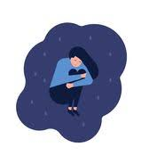
Depressive Disorders
Major Depressive Disorder
Dysthymic Disorder
Minor Depressive Disorder
Recurrent Brief Depressive Disorder
Double Depression

Slide 4
EPIDEMIOLOGY OF DEPRESSION
Depression is much more common than once thought
One of the more debilitating disorders known to humanity, as it often affects individuals during what should be their most productive years
Point prevalence for depression was 12.9 percent, the 1-year prevalence was 7.2 percent, and the lifetime prevalence was 10.8 percent

Slide 5
EPIDEMIOLOGY OF DEPRESSION
Independent of country or culture, is that depression is more common in women than men

Slide 6
EPIDEMIOLOGY OF DEPRESSION
Mean age of onset for major depressive disorder is about 40 years
50 percent of all patients having an onset between the ages of 20 and 50 years
Major depressive disorder can also begin in childhood or old age
Some epidemiologic data suggest that the incidence of major depressive disorder may be increasing among younger persons

Slide 7
EPIDEMIOLOGY OF DEPRESSION
Most often in persons without close interpersonal relationships and in those who are divorced or separated
No proven correlation between socioeconomic status and major depressive disorder
More common in rural areas than in urban areas

Slide 8
Case scenario
Ms. A is a 48-year-old white female who presented to an outpatient community mental health agency for evaluation of depressive symptoms. Over the past eight weeks she has experienced sad mood every day, which she describes as a feeling of hopelessness and emptiness. She also noticed other changes about herself, including decreased appetite, insomnia, fatigue, and poor ability to concentrate. The things that used to bring Ms. A . joy, such as gardening and listening to podcasts, are no longer bringing her the same happiness they used to. She became especially concerned as within the past two weeks she also started experiencing feelings of worthlessness, the perception that she is a burden to others, and fleeting thoughts of death/suicide.

Slide 9
CLINICAL PRESENTATION
A depressed mood and a loss of interest or pleasure are the key symptoms of depression
The classic presentation of a depressed patient is a person with a stooped posture, decreased movement, and a downward averted gaze. In practice, there is a considerable range of behaviors ranging from persons with no observable symptoms to the catatonically depressed patient

Slide 10
CLINICAL PRESENTATION
Many depressed patients have a decreased rate and volume of speech; they respond to questions with single words and exhibit delayed responses to questions
The most typical somatic symptoms of depression are called the neurovegetative symptoms of depression and typically include a variety of physical symptoms

Slide 11
Neurovegetative Symptoms of Depression
Common
Sometimes included
Fatigue, low energy
Inattention
Insomnia, early morning awakening
Poor appetite, associated weight loss
Decreased libido and sexual performance
Menstrual irregularities
Worse depression in the AM

Slide 12
Many patients have decreased appetite and weight loss, but others experience increased appetite and weight gain an sleep longer than usual
These are sometimes called reversed neurovegetative symptoms or atypical features

Slide 13
DSM5 Criteria
A . Five (or more) of the following symptoms have been present during the same 2-week period and represent a change from previous functioning: at least one of the symptoms is either (1) depressed mood or (2) loss of interest or pleasure.
Note: Do not include symptoms that are clearly attributable to another medical condition.
Depressed mood most of the day, nearly every day, as indicated by either subjective report (e.g., feels sad, empty, and hopeless) or observation made by others (e.g., appears tearful). (Note: In children and adolescents, can be irritable mood.)
Markedly diminished interest or pleasure in all, or almost all, activities most of the day, nearly every day (as indicated by either subjective account or observation).
Significant weight loss when not dieting or weight gain (e.g., a change or more than 5% of body weight in a month), or decrease or increase in appetite nearly every day. (Note: In children, consider failure to make expected weight gain.)
Insomnia or hypersomnia nearly every day.
Psychomotor agitation or retardation nearly every day (observable by others, not merely subjective feelings or restlessness or being slowed down).

Slide 14
DSM5 Criteria
6 ( Fatigue or loss of energy nearly every day
7( Feelings of worthlessness or excessive or inappropriate guilt (which may be delusional) nearly every day (not merely self-reproach or guilt about being sick)
8) Diminished ability to think or concentrate, or indecisiveness, nearly every day (either by
subjective account or as observed by others)
Recurrent thoughts of death (not just fear of dying), recurrent suicidal ideation without a specific plan, or a suicide attempt or a specific plan for committing suicide.

Slide 15
DSM5 Criteria
B. The symptoms cause clinically significant distress or impairment in social, occupational, or other important areas of functioning
C. The episode is not attributable to the physiological effects of a substance or to another medical condition
D .The occurrence of the MDE is not better explained by schizoaffective disorder, schizophrenia, schizophreniform disorder, delusional disorder, or other specified and unspecified schizophrenia spectrum and other psychotic disorders
E. There has never been a manic episode or a hypomanic episode

Slide 16
CLINICAL PRESENTATION
Patients feel “bad” and may use words such as “sad,” “depressed,” “blue,” “down,” or similar words to describe this feeling
Here we use the term dysphoria to encompass these various depressive feelings as a way to avoid the confusion inherent in using the word “depressed” to mean both the diagnosis and the core symptom
Also, many patients are reluctant to use the word “depressed” as they may have difficulty coming to terms with their diagnosis. In such cases, other synonyms, including those above, may seem less threatening to the patient
Some patients deny dysphoria altogether, but instead, describe feeling unable to enjoy things that are usually enjoyable to them. We call this anhedonia or a lack of pleasure.
In addition to dysphoria and anhedonia, many depressed patients also report feeling anxious

Slide 17
CLINICAL PRESENTATION
The critical point is that although sadness and even depression may be, in themselves, normal reactions, when encountered in the context of a depressive disorder, patients do not experience them as normal
Patients will often feel genuinely ill and be able to distinguish their emotional state from “normal” feelings of sadness
Many will first interpret this as indicative of medical illness and present to their primary care doctor complaining of feeling “sick” rather than depressed

Slide 18
CLINICAL PRESENTATION
Negative views of the world and themselves
Thought content often includes nondelusional ruminations about loss, guilt, suicide, and death
About 10 percent of all depressed patients have marked symptoms of a thought disorder, usually thought blocking and profound poverty of content
Depressed patients may complain of either delusions or hallucinations associated with their depressive episode

Slide 19
CLINICAL PRESENTATION
About two-thirds of all depressed patients contemplate suicide, and 10 to 15 percent commit suicide

Slide 20
CLINICAL PRESENTATION
About 50 to 75 percent of all depressed patients have some measure of cognitive impairment
Some depressed patients sometimes seem unaware of their depression and do not complain of a mood disturbance even though they exhibit withdrawal from family, friends, and activities that previously interested them

Slide 21
With Psychotic Features
With Melancholic Features
With Atypical Features
With Catatonic Features
Postpartum Onset(with peripartum onset)
With Seasonal Pattern
Tend to experience depressive episodes during a particular season, most commonly winter

Slide 22
Dysthymic Disorder
Presence of depressive symptoms that are less severe than those of major depressive disorder
Often more chronic
The most typical feature of dysthymia, also known as persistent depressive disorder, is the presence of a depressed mood that lasts most of the day and is present almost continuously
Associated feelings of inadequacy, guilt, irritability, and anger; withdrawal from society; loss of interest; and inactivity and lack of productivity

Slide 23
Other Diagnoses
Minor Depressive Disorder
Recurrent Brief Depressive Disorder
Double Depression

Slide 24
DIFFERENTIAL DIAGNOSIS
Symptoms of depressive disorders commonly overlap with other
syndromes and disorders
General Medical Disorders
Other Mental Disorders

Slide 25
Pharmacologic Factors and Physical Diseases Associated with Onset of Depression
Pharmacologic
Steroidal contraceptives
Reserpine, methyldopa
Anticholinesterase insecticides
Amphetamine or cocaine withdrawal
Alcohol or sedative–hypnotic withdrawal
Cimetidine, indomethacin
Phenothiazine antipsychotic drugs
Thallium, mercury
Cycloserine
Vincristine, vinblastine
Interferon

Slide 26
Endocrine–metabolic
Hypothyroidism and hyperthyroidism
Hyperparathyroidism
Hypopituitarism
Addison disease
Cushing syndrome
Diabetes mellitus
Infectious
General paresis (tertiary syphilis)
Toxoplasmosis
Influenza, viral pneumonia
Viral hepatitis
Infectious mononucleosis
Acquired immune deficiency syndrome

Slide 27
Collagen
Rheumatoid arthritis
Lupus erythematosus
Nutritional
Pernicious anemia
Pellagra

Slide 28
Neurologic
Multiple sclerosis
Parkinson disease
Head trauma
Complex partial seizures
Sleep apnea
Cerebral tumors
Cerebrovascular infarction (and disease)
Neoplastic
Abdominal malignancies
Disseminated carcinomatosis

Slide 29
TREATMENT APPROACH
1
2
3
STEP
STEP
STEP
Patient’s safety must be guaranteed
complete diagnostic evaluation of the patient is necessary
Not only
the immediate symptoms but also the patient’s prospective well-being

Slide 30
Hospitalization
1
Risk of suicide or homicide
2
A patient’s grossly reduced ability to get food and shelter
3
Need for diagnostic procedures

Slide 31
Choosing a Treatment
Combined Treatments May Offer the Best Option
We often combine medication and psychotherapy

Slide 32
Somatic Treatments
Pharmacotherapy
Other Somatic Treatments
Vagal Nerve Stimulation
Transcranial Magnetic Stimulation
PHOTOTHERAPY
ECT

Slide 33
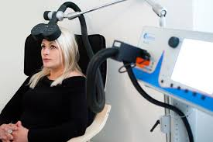
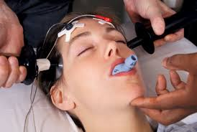

Slide 34
Psychosocial Therapy
Cognitive Therapy
Interpersonal Therapy
Behavior Therapy
Psychoanalytically Oriented Therapy
Family Therapy

Slide 35
Bipolar Disorder
Bipolar type 1
Bipolar Type 2
Other Bipolar Disorders :
Cyclothymia

Slide 36
BIPOLAR CLINICAL PRESENTATION

Slide 37
Manic Episodes
Excited, talkative, sometimes amusing, and frequently hyperactive
Their speech is usually rapid and loud and challenging to interrupt
Pressured speech is considered a hallmark of mania
An elevated, expansive, or irritable mood is the hallmark of a manic episode
Manic patients may be emotionally labile,switching from laughter to irritability to depression in minutes or hours
Delusions occur in 75 percent of all manic patients

Slide 38
Manic Episodes
Bizarre and mood-incongruent delusions and hallucinations also appear in mania
Impaired judgment is a hallmark of manic patients
About 75 percent of all manic patients are assaultive or threatening at some time
Manic patients are at increased risk for suicide

Slide 39
Depressive Episodes
The depressive episodes in bipolar disorder are similar to those described for depressive disorders
Many experts in the field feel that there are qualitative differences in the depressive episodes experienced by bipolar patients

Slide 40
Bipolar I Disorder
At least one manic episode

Slide 41
Bipolar II Disorder
Hypomania rather than mania
Manic-type symptoms that are not as severe or as impairing as full mania

Slide 42
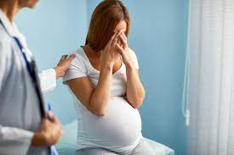
With Peripartum Onset
Mania occurring after pregnancy is a critical issue given the potential risk to the child

Slide 43
Differential Diagnosis of Mania
Medical
AIDS/HIV
Substance induced
Antidepressant-induced mania
Psychiatric
Atypical psychosis
Delirium
Hyperthyroidism
Postencephalitic syndrome
Steroid-induced mania
Amphetamine-induced mania
Cocaine-induced mania
Phencyclidine-induced mania
Alcohol intoxication
L-Dopa–induced mania
Bronchodilator-induced mania
Decongestant-induced mania
Bipolar disorder
Catatonic schizophrenia
Schizoaffective disorder

Slide 44
CYCLOTHYMIC DISORDER
A mild form of bipolar II disorder, characterized by episodes of hypomania and mild depression
In DSM-5, cyclothymic disorder is defined as a “chronic, fluctuating mood disturbance” with many periods of hypomania and of depression.
The disorder is differentiated from bipolar II disorder, which is characterized by the presence of major (not minor) depressive and hypomanic episodes.

Slide 45
Medical Conditions
However, a wide range of medical disorders and substances can cause manic symptoms
Antidepressant treatment can also be associated with the precipitation of mania in some patients

Slide 46
COMORBIDITY
Men
Substance use Disorder
women
Anxiety Disorder
Eating Disorder

Slide 47
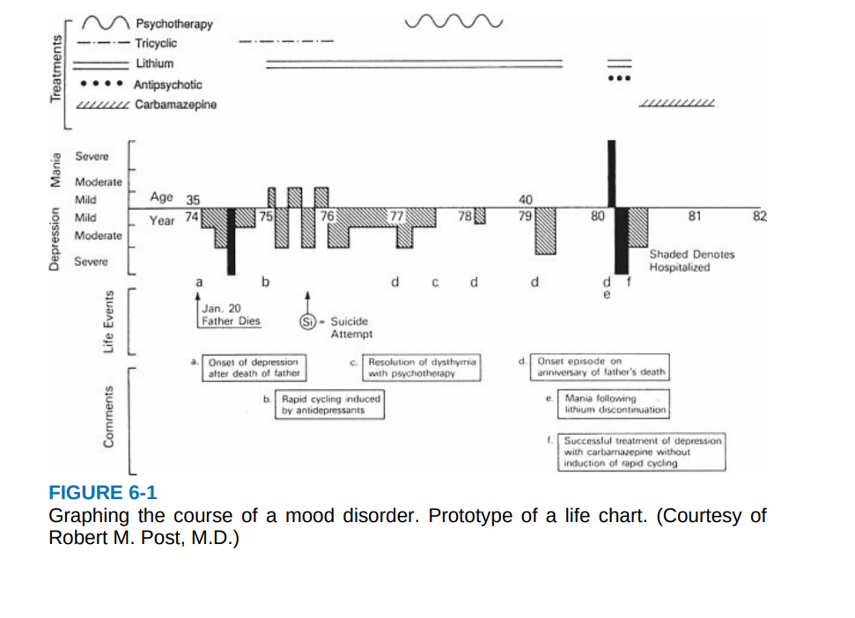

Slide 48
Onset
About 5 to 10 percent of patients with an initial diagnosis of major depressive disorder have a manic episode 6 to 10 years after the first depressive episode
The mean age for this switch is 32 years, and it often occurs after two to four depressive episodes.
Bipolar I disorder most often starts with depression (75 percent of the time in women, 67 percent in men) and is a recurring disorder
Most patients experience both depressive and manic episodes, although 10 to 20 percent experience only manic episodes.

Slide 49
Duration
The manic episodes typically have a rapid onset (hours or days) but may evolve over a few weeks.
An untreated manic episode lasts about 3 months; therefore, clinicians should not discontinue giving drugs before that time.
Of persons who have a single manic episode, 90 percent are likely to have another.
As the disorder progresses, the time between episodes often decreases
After about five episodes, however, the interepisode interval often stabilizes at 6 to 9 months
Of persons with bipolar disorder, 5 to 15 percent have four or more episodes per year and are classified as rapid cyclers.

Slide 50
Prognostic Indicators
A poor prognosis
A premorbid poor occupational status
Alcohol dependence
Psychotic features
Depressive features
Interepisode depressive features
Male gender

Slide 51
Prognostic Indicators
A better outcome
A short duration of manic episodes
Advanced age of onset
Few suicidal thoughts
Few coexisting psychiatric or medical problems

Slide 52
TREATMENT APPROACH
Hospitalization
Pharmacotherapy
Electroconvulsive Therapy
Psychosocial Therapy

Slide 53
Thanks for your Attention

